Slide 1
Unit 6: Working with Messy Data
gaurav Kulkarni

Slide 2
Contents
Messy Data
Renaming Columns (Variable Names)
Attaching / Detaching
Tabulating Data: Constructing Simple Frequency Tables
Ordering Factor Variables
Summary

Slide 3
Introduction
Real world data is messy. Very often the data file that you start out with doesn’t have the variables stored in the right format for the analysis you want to do.
This can range from the way they are named to how they are coded. At times there might be some missing values in your dataset.
Unit 03 : 1) To remove missing values or NAs from our data . 2) A subset of your data.
In this session we’ll work with some messy data to learn how to format and properly code variables, create simple frequency tables, and review a few graphing techniques to help us better analyze our data.

Slide 4
Messy Data
Surveys with close-ended questions typically yield nice and neat datasets of results. However, this short survey produced a pretty complex and messy dataset that makes it difficult to work with.
Let’s take a closer look.
Download the dataset of survey results from: http://becomingvisual.com/rfundamentals/undergrad.csv

Slide 5
Messy Data
Then, import the undergrad.csv dataset into RStudio. As described in Unit 3, simply select Import Dataset > From CSV File … from the workspace pane.
Then be sure to convert the data to a data frame
undergrad <-data.frame(undergrad)
View(undergrad)
Carefully review the data. You’ll notice that is has 39 observations and 11 variables. Take note of what you see as messy with this data.
Lots of text?
The long column names?
The missing data?

Slide 6
Messy Data
Also, review the columns that correspond to the responses for questions 1 through 4. The questions require a response on a 7-point Likert scale. However, for question 1 the responses are in text form whereas in questions 2, 3, and 4 are numeric. As we saw in the previous lessons, we need our data in a numeric format of sorts to perform any calculations.

Slide 7
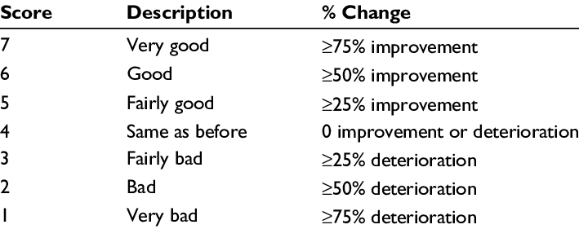
Likert scale Likert scale is a psychometric scale commonly involved in research that employs questionnaires. It is the most widely used approach to scaling responses in survey research

Slide 8
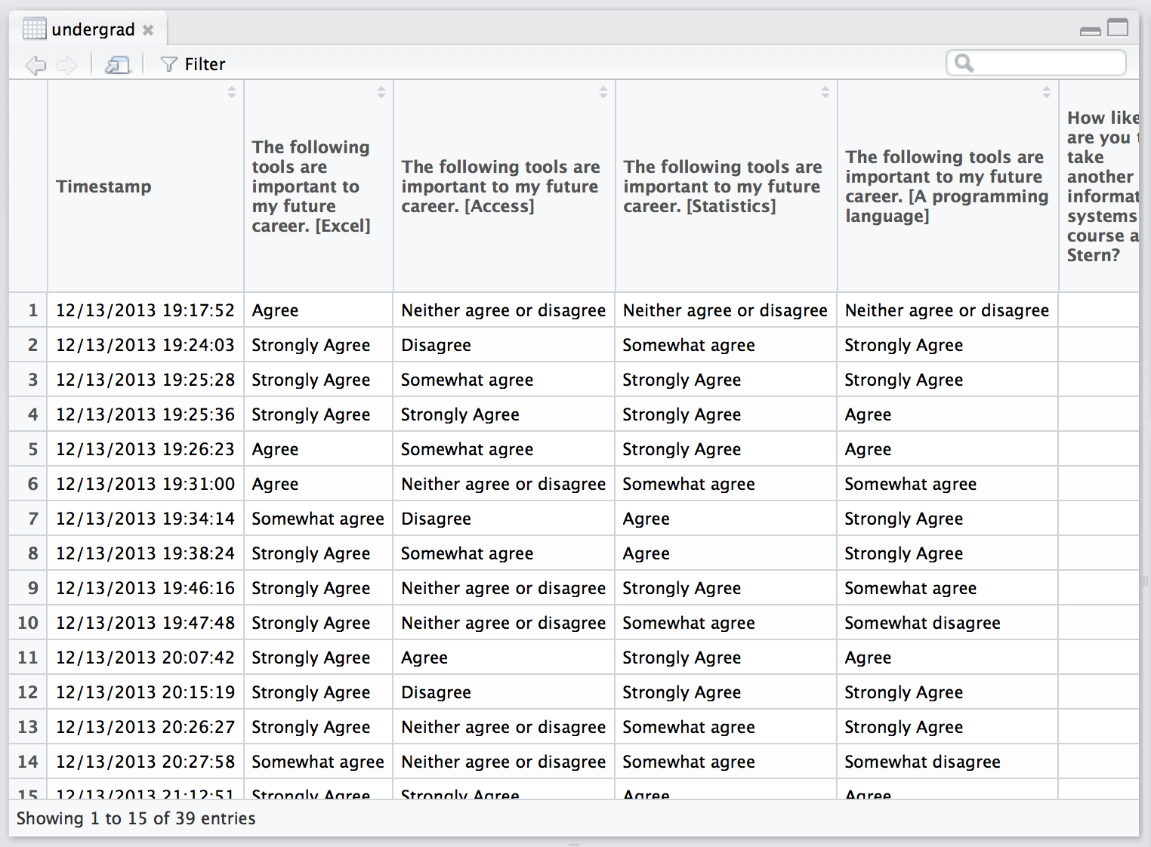
Renaming columns (variable names)
As you view the data, you probably noticed that the column names are very long,

Slide 9
Renaming columns (variable names)
We can use the names( ) function to rename each of the columns in undergrad. Just be sure the variable name you type in corresponds to the correct variable. The names need to be written in the order as the columns appear in the data frame.
Create an RScript. Begin by creating an RScript for this lesson. This will help you keep track of your work and repeat commands as necessary. Note: The examples in this lesson will still include the > to indicate an R prompt.

Slide 10
Renaming columns (variable names)
(1) Go to File > New > RScript.
(2) Next, save your RScript as undergrad.R
(3) Rename the undergrad data frame using the names( ) function as described above.
names(undergrad) <- c("timestamp","excel","access", "statistics", "programming", "iscourse", "cscourse", "topics", "istopics", "onlinecourse", "concentration")
(4) Run your undergrad.R script.
(5) Now, view the undergrad data frame to check to see if the column names were changed.

Slide 11
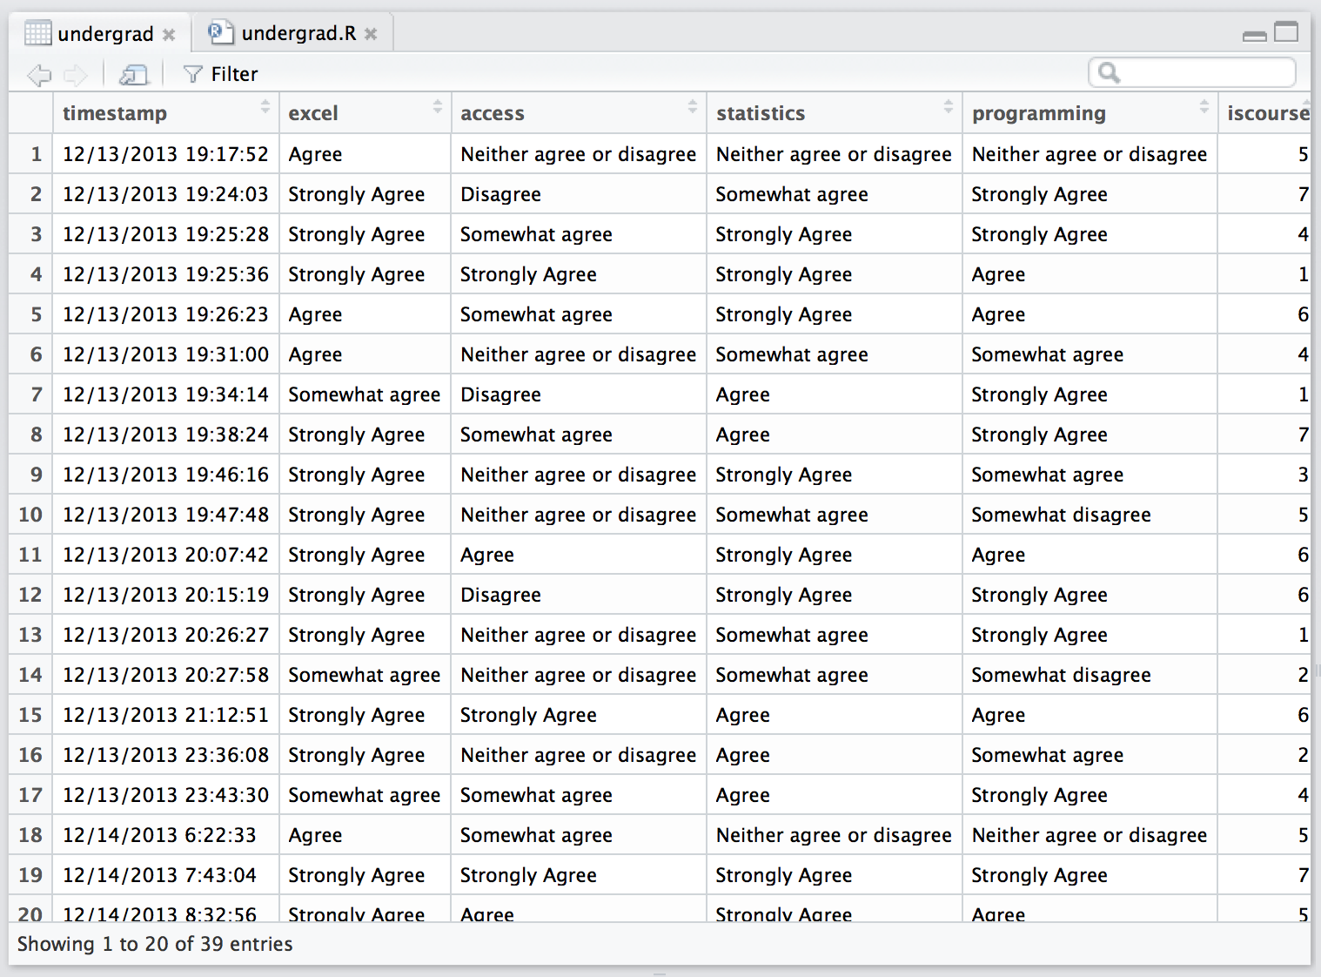

Slide 12
Attaching / Detaching
You can make your data manipulation and analysis of the undergrad data frame a little more efficient by using the attach( ) function. The attach( ) function enables you to work with a data frame variables directly without explicitly referencing the name of the data frame. It saves the reference to the data frame in your R path. For example, to view the data in the excel variable of the undergrad data frame you would normally have to enter:

Slide 13
Attaching / Detaching
To see all the values for the variable excel you would have to type data frame$variable (e.g. undergrad$excel).
Instead you can use the attach( ) function and reference any variable in the undergrad data frame directly.
Try using the attach( ) function.
#adding undergrad to my R path for easy access and reference of variables attach(undergrad) #referencing the excel variable directly excel
Note: It’s important to use the detach( ) function when you finished working with a particular data frame.
detach(undergrad)

Slide 14
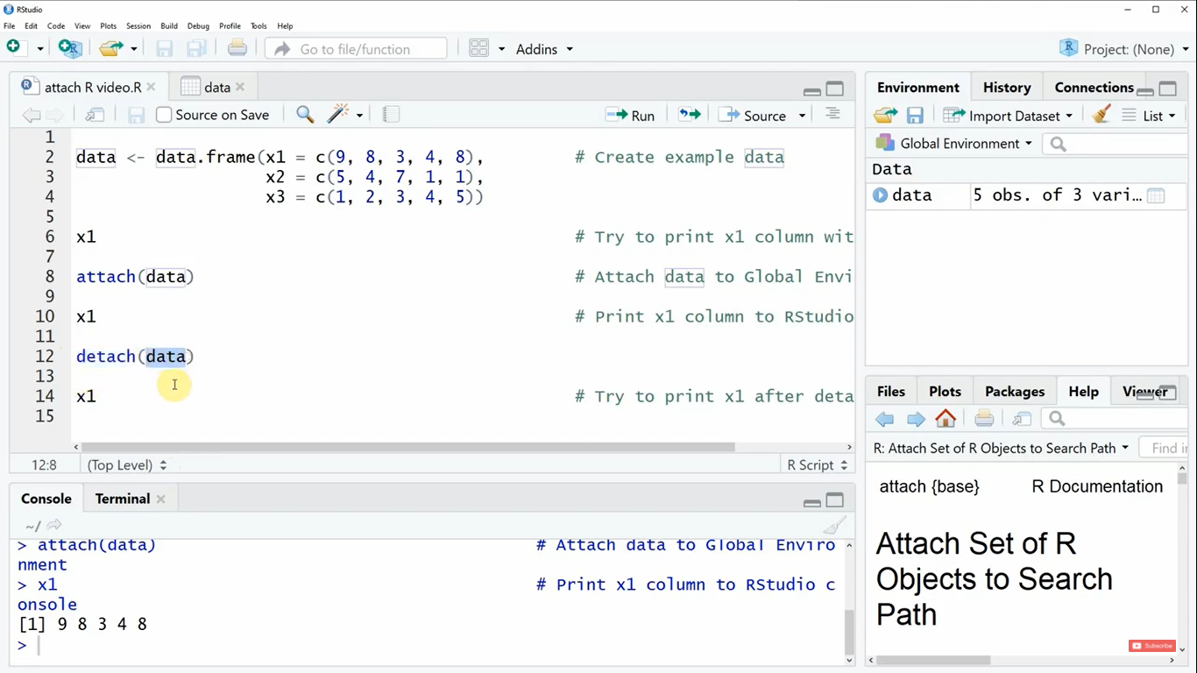

Slide 15
Tabulating data: Constructing simple frequency tables and histograms
A typical data analysis task is to construct a frequency table or cross-tabulation of one variable to another. Let’s begin by looking at two variables: iscourse and cscourse. These variables refer to the likeliness that the respondent will take another course in the field of Information Systems or Computer Science. We are selecting these two variables because, as we saw before, the responses to this question were coded as numbers.

Slide 16
Frequency counts.
A simple frequency count of the number of respondents per response category will help us analyze the results. We can use the table( ) function to tabulate the results of each variable:
table(iscourse)
## iscourse
## 1 2 3 4 5 6 7
## 6 3 1 8 5 10 6
table(cscourse)
## cscourse
## 1 2 3 4 5 6 7
## 3 5 2 6 5 7 11

Slide 17
Visualizing the results.
hist( ) function
mean() and median()

Slide 18
Frequency counts.
table(excel)
## excel
## Agree Somewhat agree Strongly Agree
## 9 3 27
table(access)
## access
## Agree Disagree
## 5 5
## Neither agree or disagree Somewhat agree
## 9 10
## Somewhat disagree Strongly Agree
## 2 8

Slide 19
Frequency counts.
Next, let’s visualize the access frequency table by creating a histogram.
hist(access)
Error in hist.default(access) : 'x' must be numeric
It looks like we cannot create a histogram with the data when it is a chaacter. To solve this, we can simply “cast” that variable to a different type. In this case, we want to change the data type of access to a factor and cast access using the as.numeric( ) function to plot our histogram.

Slide 20
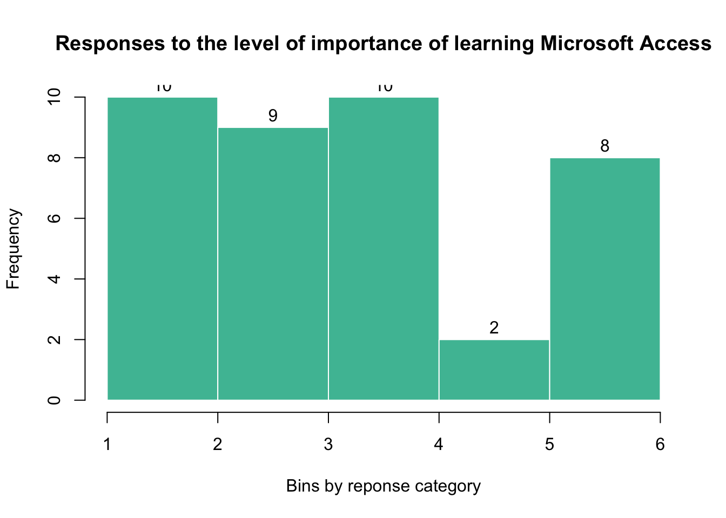

Slide 21
Histograms
figure06
## $breaks
## [1] 1 2 3 4 5 6
##
## $counts
## [1] 10 9 10 2 8
##
## $density
## [1] 0.25641026 0.23076923 0.25641026 0.05128205 0.20512821

Slide 22
However, we see in Figure, that the histogram is not very useful in helping us interpret our data. We can clearly see that the values on the x-axis (our ordinal data) do not necessary match what we’d like to see bsed on our frequency table. Specifically, it’s unclear what the numbers 1-6 mean on the x-axis. Furthermore, it doesn’t seem as though they are in any specific order. For example, if you look at the first bin in the histogram there are 10 observations. If you recall from earlier, the only value that has 10 observations in the access frequency table is “Somewhat Agree”.

Slide 23
Ordering factor variables
To order a factor variable we can use the ordered( ) function and set the levels in the order we want them.
access-ordered <- ordered(x=access, levels=c("Strongly disagree","Disagree","Somewhat disagree","Neither agree or disagree","Somewhat agree","Agree","Strongly Agree"))
View the data and levels for the access variable.
access-ordered

Slide 24
We can see that the levels represent degrees. For example, the value of Disagree is > (greater than) than the value for Strongly Disagree.
Another way to see the attributes of a variable is to use the attributes( ) function.
attributes(access-ordered)

Slide 25
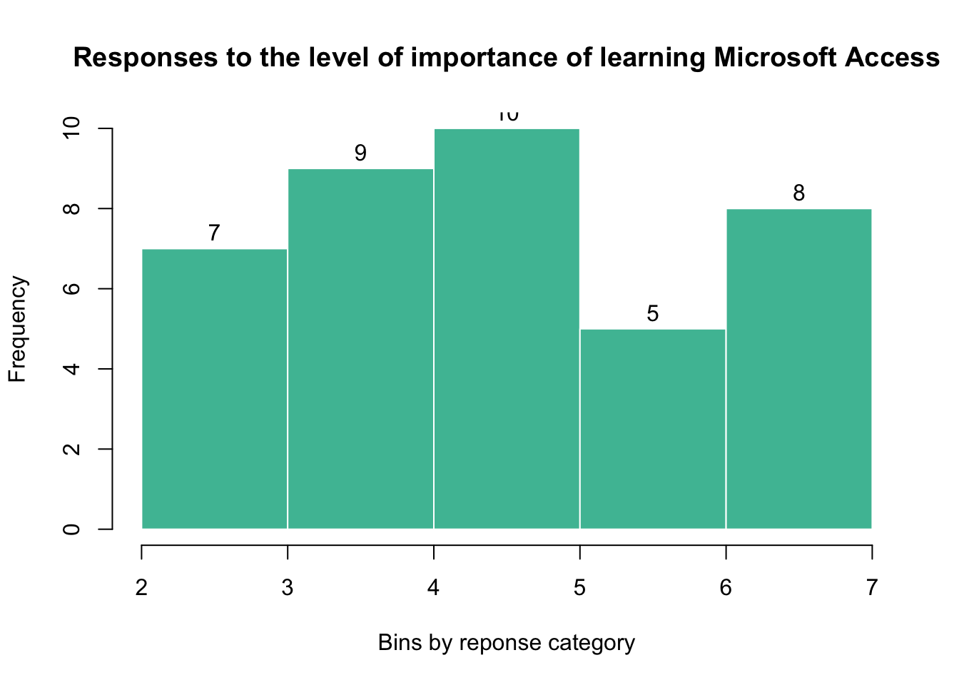
figure07 <- hist(as.numeric(access_ordered),breaks=7, main = "Responses to the level of importance of learning Microsoft Access", xlab = "Bins by reponse category", col="#4cbea3", labels=TRUE, border="#FFFFFF")

Slide 26
How to Work with Ordered Factors in R
Ordinal data is a categorical, statistical data type where the variables have natural, ordered categories and the distances between the categories are not known.
Examples of ordinal variables include:
socio economic status (“low income”,”middle income”,”high income”),
education level (“high school”,”BS”,”MS”,”PhD”),
income level (“less than 50K”, “50K-100K”, “over 100K”),
satisfaction rating (“extremely dislike”, “dislike”, “neutral”, “like”, “extremely like”)

Slide 27
In R, there is a special data type for ordinal data. This type is called ordered factors and is an extension of factors
To create an ordered factor in R, you have two options:
Use the factor() function with the argument ordered=TRUE.
Use the ordered() function.
For Example if you want to represent the status of five projects. Each project has a status of low, medium, or high:
> status <- c("Lo", "Hi", "Med", "Med", "Hi")

Slide 28
Now create an ordered factor with this status data:
ordered.status <- factor(status, levels=c("Lo", "Med", "Hi"), ordered=TRUE)
ordered.status
[1] Lo Hi Med Med Hi
Levels: Lo < Med < Hi

Slide 29
You can tell an ordered factor from an ordinary factor by the presence of directional signs (< or >) in the levels.
> table(status)
status
Hi Lo Med
2 1 2
Notice that the results are ordered alphabetically. However, the results of performing the same function on the ordered factor yields results that are easier to interpret because they’re now sorted in the order Lo, Med, Hi:

Slide 30
R preserves the ordering information inherent in ordered factors.
> table(ordered.status)
ordered.status
Lo Med Hi
1 2 2

Slide 31
Thank You

